Slide 1
Data Science Job Locator for the 2024 Economy
Chris Coble

Slide 2

What is this Model for?
Navigating the economic waters of the U.S. can be complicated for data scientists looking for work considering job industry, job wages, supply of jobs, and more
By strategically knowing your desired salary range and how competitive you are in the marketplace, you can determine which area is best for you to work from this model
https://emeritus.org/in/learn/what-are-the-roles-and-responsibilities-of-a-data-scientist/

Slide 3
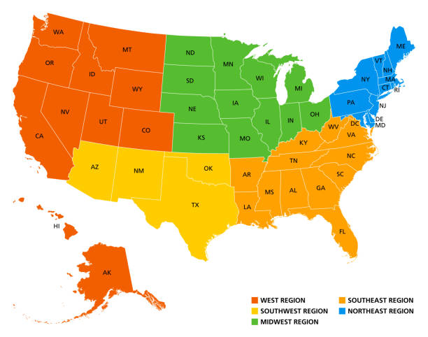
How is the Model Helpful?
Informs data scientist where are the best areas to apply to based on:
Desired salary
How competitive you are professionally
https://www.istockphoto.com/photos/us-map-regions

Slide 4


Where is the Data coming from?
Dataset from kaggle, detailing Glassdoor Data Science job posts in 2024
Dataset from the BLS on the 2023 Data Science professionals employment statistics
Merged frame contains: salaries of posts, company names, titles, rating, total employed in state of company, ratio of salary to the state mean, etc.
Sources:
Kaggle link: https://www.kaggle.com/datasets/ritiksharma07/data-science-job-listings-from-glassdoor
BLS report: https://docs.google.com/spreadsheets/d/e/2PACX-1vQqE7UY0Aj_ChNrRRBwyvHl4eghJ3ZdHUqwbPE9NO-lfg_Tlm2dEkDo6SXwJg0sOg/pubhtml

Slide 5
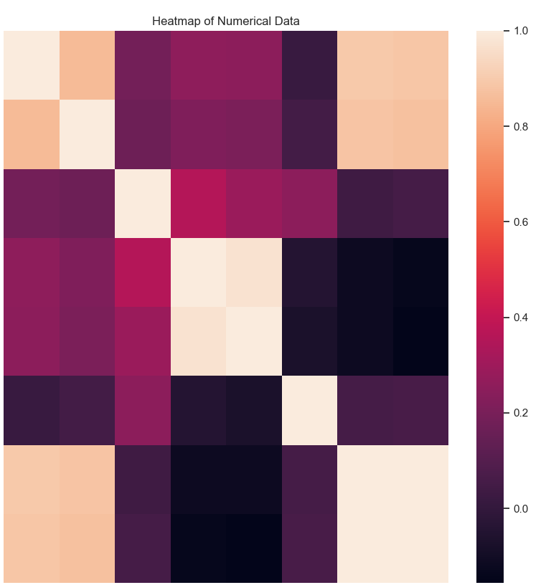
Data is Not Appropriate for Regression
Heatmap shows lack of correlation amongst the non-related numerical features within dataframe
Regression will be difficult for this data
Numeric Features
Upper salary
Lower salary
Total Employment in State
Annual Mean Wages
Annual Median Wages
New Posts to Total Jobs Ratio
Post Salary to Annual Mean Ratio
Post Salary to Annual Median Ratio

Slide 6
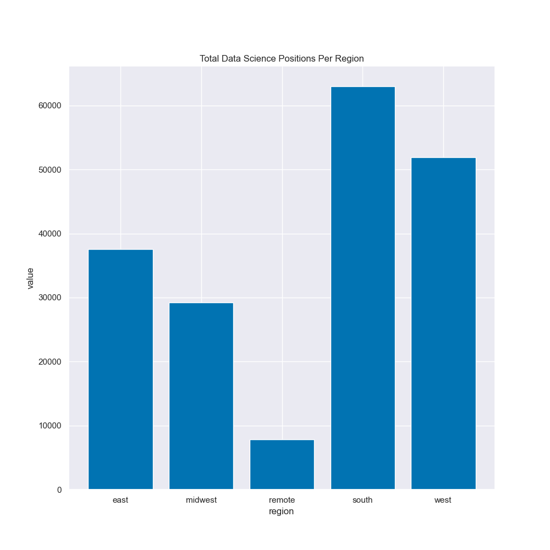
Regionalization Reveals Useful Information
Applying economic regions to data (labelling), shows solid group identities
Will this be a classification model?

Slide 7
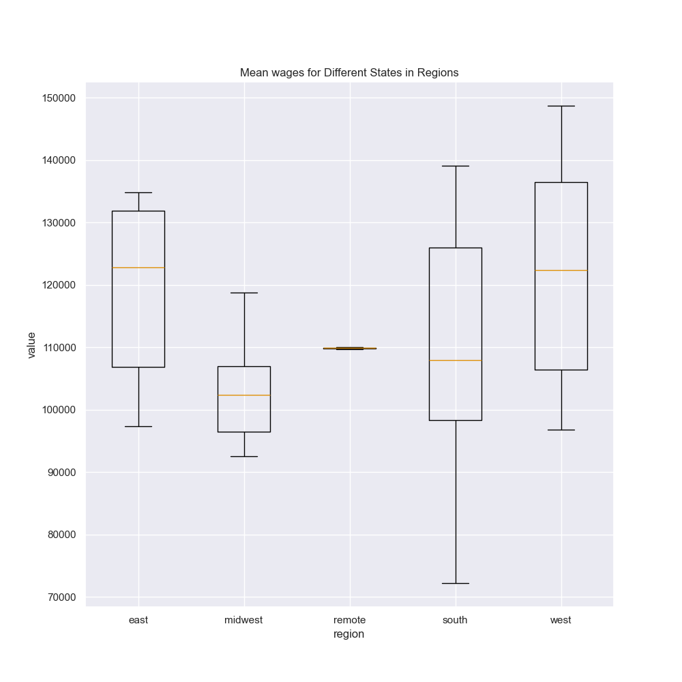
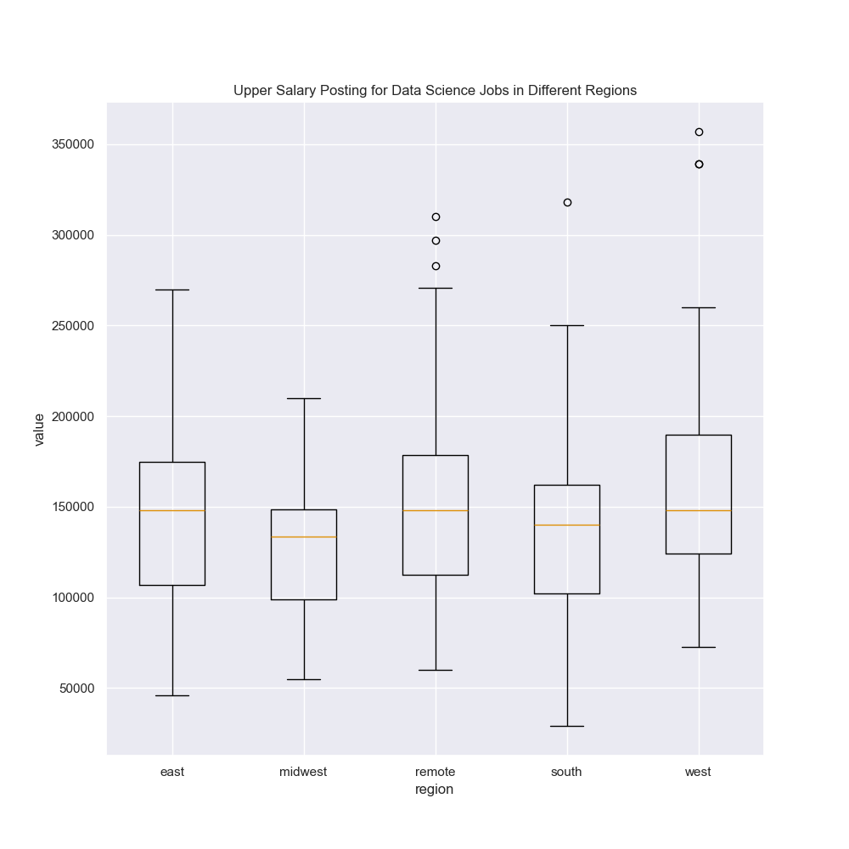
Classification is Appropriate
Mean distributions and post’s salary unique regional distributions indicate classification is a wise choice

Slide 8
Model Training Results
The results of the training are below:
Training Model Results
 | Models
 | Random_Forest | K_Nearest | Gradient_Boosted | Deep Neural Network
accuracy | 0.9565217391 | 0.8260869565 | 0.9710144928 | 0.2753623188
precision | 0.9612121212 | 0.8309178744 | 0.9723320158 | 0.2615200336
recall | 0.9565217391 | 0.8260869565 | 0.9710144928 | 0.2028985507
f1 | 0.9572763727 | 0.8202731246 | 0.9712174725 | 0.2341322712
Considering all metrics, the order of performance was:
Gradient Boosting
Random Forest
K Nearest
Deep Neural Network

Slide 9
Final Modeling Results
Final Models Hyperparameter Tunings
Random Forest Classifier |  | K Nearest Neighbors |  | Gradient Boosted Classifier |  | Deep Neural Network
Hyperparameters | Tuning Value | Hyperparameters | Tuning Value | Hyperparameters | Tuning Value | Hyperparameters | Tuning Value
n_estimators | 300 | leaf_size | 20 | learning_rate | 0.05 | epoch | 500
criterion | gini | n_neighbors | 7 | max_depth | 5 | batch_size | 16
 |  | p | 1 | max_features | 6 | validation split | 0.2
 |  | weights | distance | n_estimators | 75
My input: $110000 - $130000 and 0.8 confidence
Random_Forest: Remote
K_Nearest: Remote
Gradient_Boosted: Midwest
Deep_Neural_Network: Remote

Slide 10
Personal Results and Recommendation
I will try and take the midwest suggestion. I think that it is wise not only because the decision is coming from the most confident model, but because I don’t want to work remote.
I will look into applying at the follow companies listed in the kaggle dataset for entry level positions in the midwest region.
I am excited to see what I find!

Slide 11
Furthering Usage of Model
Model can be used to determine if you are being paid fairly for current data scientist role
Just alter the salary until your region is produced by the model, which will reveal if you are being compensated appropriately

Slide 12

Future work: more data
Input the BLS report on the 2024 Data Science employment statistics when released
Update with new job posts on Glassdoor in the summer of 2024
See if removing outliers changes performance on the gradient boosted classifier vs. the K Neighbors Classifier
Make stratifications of titles in the region, so that the salary input reflects the jobs corresponding to those salaries only

